Slide 1
Part 14 PIP in Python
Version: 3.o
Written by: Babar ali

Slide 2
What is PIP in Python?
PIP is a package manager for Python. That means it’s a tool that allows you to install and manage additional libraries that are not distributed as part of the standard library.
The concept of a package manager might be familiar to you if you are coming from other languages. JavaScript uses npm for package management, Ruby uses gem, and .NET use NuGet. In Python, pip has become the standard package manager.

Slide 3
How to check and install PIP?
To check the pip is install in your PC write the following commands.
(check the version of PIP)
>>> pip --version
If you do not have PIP installed, you can download and install it from this page:
https://pypi.org/project/pip/

Slide 4
How to download package using PIP?
Open the command line interface and tell PIP to download the package you want.
(install the package using PIP)
>>> pip install camelcase
Now you have downloaded and installed your first package!

Slide 5
Using a package
Once the package is installed, it is ready to use.
# import the camelcase library
import camelcase
c = camelcase.CamelCase()
text = "hello world"
# convert text to camelcase
print(c.hump(text))
Find more packages at :
https://pypi.org/

Slide 6
How to Remove Packages?
Once Use the uninstall command to remove a package:
(Remove the package using “unistall” word)
>>> pip uninstall camelcase
The PIP will prompt you are you sure want to remove the package.
Hit “Yes” if you want to remove or hit “No”.

Slide 7
List of packages in PIP
Use the list command to list all the packages installed on your system.
(show all the packages when I was installed)
>>> pip list
This will show all the list of package that you have installed previously.

Slide 8
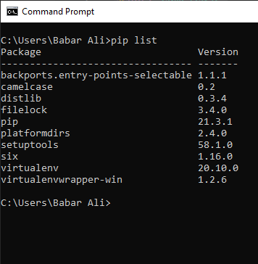
Screen shot of all the list of packages

Slide 9
Thanks for Reading

